Slide 1
IST 615 Final Presentation
C02 and Carbon Emissions Tracking in the Cloud
Yesul Song, Zane Alderfer, Sophie Panagrossi, Benjamin Tisinger

Slide 2

The Carbon Tracking Challenge
Disparate Data Sources: Operations and supply chains generate emissions data in silos, complicating holistic analysis and response strategies.
Lack of Real-Time Monitoring: Absence of immediate emissions data prevents swift action, allowing unnecessary environmental impact and inefficiencies to persist.
Financial and Operational Consequences: Companies face up to $100,000 annually in regulatory fines, lost opportunities, and surging operational costs due to inefficient carbon management practices.

Slide 3

Who’s at Risk?
The Organization:
Regulatory Risks: Non-compliance with environmental regulations increases vulnerability to fines and sanctions.
Financial Risks: Inefficient carbon management escalates costs and erodes competitive edge in increasingly eco-conscious markets.
Reputational Risks: Perceived negligence in sustainability efforts undermines brand loyalty and stakeholder trust.
Community & Environment:
Health and Safety Risks: Elevated pollution levels contribute to health hazards and compromised quality of life.
Economic Impacts: Climate change exacerbates resource scarcity, affecting food security, infrastructure stability, and community livelihoods.
Social and Ecological Threats: Unchecked emissions threaten biodiversity, leading to ecosystem imbalance and undermining community resilience to environmental changes.
Stakeholders (Customers and Investors):
Transparency and Accountability Expectations: Increasing demands for clear, verifiable actions towards environmental sustainability.
Ethical Investment Decisions: Growing trend of basing investment choices on corporate environmental responsibility, affecting capital inflow and valuation.
Long-term Sustainability Concerns: Stakeholders are vested in the longevity and ethical stance of their investments, aligning financial health with planetary well-being.

Slide 4
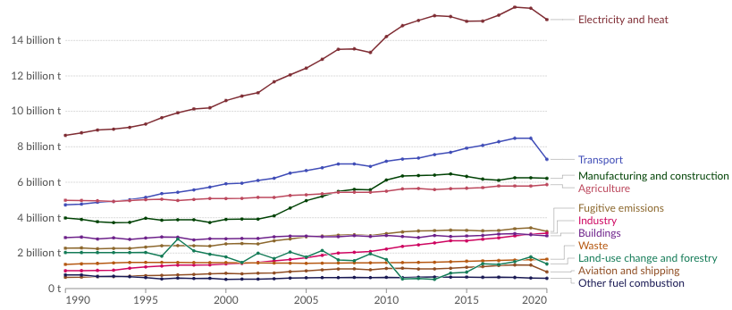
Why should we care?
Gradual increase in carbon emissions across all industries
Higher overall awareness to impact of increased greenhouse gas emission
Companies should be held accountable and transparent for their part in the rise of carbon emissions
Sectors like manufacturing and construction or transportation could benefit from monitoring their emissions
Cloud Technology exists in which we can identify these points of emissions within companies and develop steps to work toward a greener workplace

Slide 5
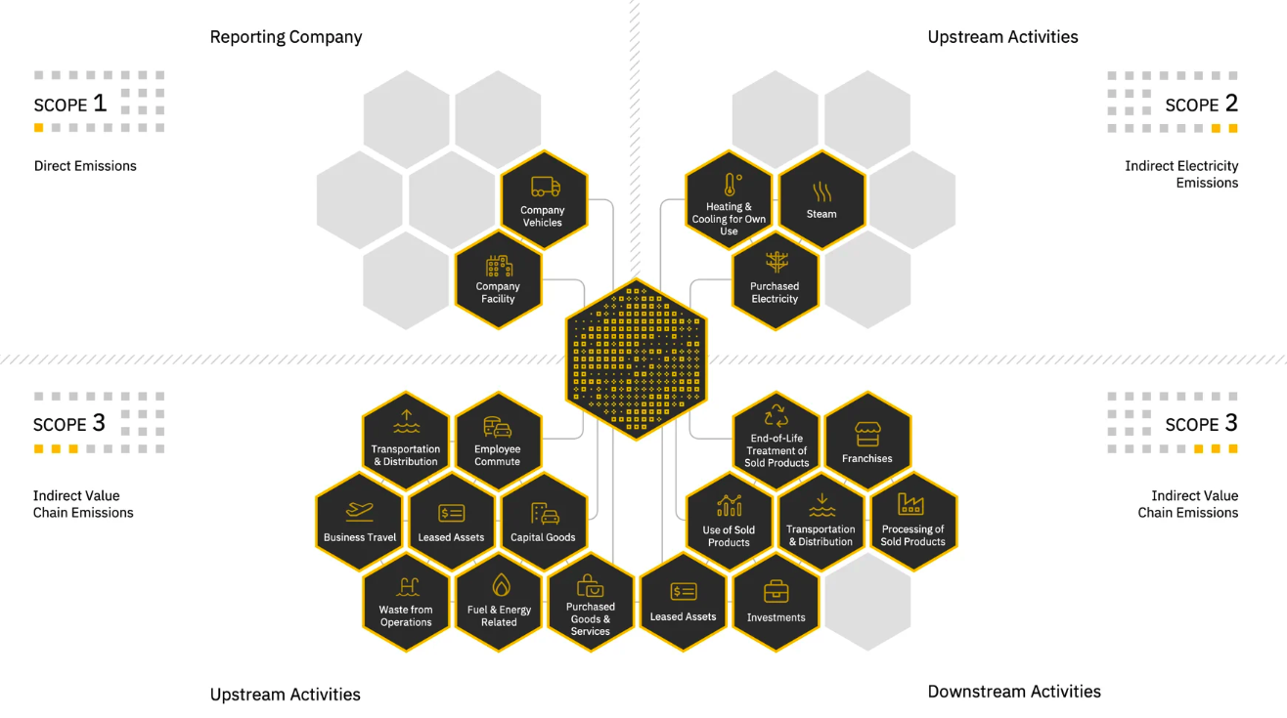
Proposition
Leverage existing software or cloud applications that can monitor or track emissions
Sensors on everything involved (factories, vehicles, plants, etc.)
Pinpoint the highest points of emissions with these sensor devices
Develop plans to mitigate the high points of emissions
The specifics will be discussed later
Important to note that our cloud application is responsible for identifying points of emissions but further work is needed to minimize these emissions

Slide 6

Goal
The ultimate goal would be to bring awareness to these companies to identify where they can be better in terms of greener practices
Keeping the welfare or future generations in mind would be vital in accepting our new cloud technology
The hardest part would be companies willingness to acclimate to greener practices do to the possibility of higher costs or more work
Our cloud application is meant to help long term and should be considered an investment

Slide 7
Propose Cloud Design
Components in Cloud Design:
Co2 and Carbon Sensors (Installation)
AWS Secure IoT Gateway
AWS Kinesis Data Stream
AWS S3 Storage
AWS Glue
AWS Glue Data Brew
Snowflake
Tableau, PowerBI, Excel
Co2 Sensors - Reporting Live Data with Feed to AWS
Secure IoT Gateway - Sends Receives Messages from Connected Devices
AWS Kinesis Data Stream - Transfer Protocol - Serverless - Data Stream
AWS S3 Storage - Object Storage - Scale up and Down - Hold Data
AWS Glue - Data Discovery and Insights - Data Preparation
Glue Data Brew - Add On for Data Cleaning and Manipulation - 250 Manipulations
Snowflake - Cloud Data Storage - S3 Buckets Integration - Query Compiler
Tableau , PowerBi and Excel - Data Presentation Layer and Visualization

Slide 8
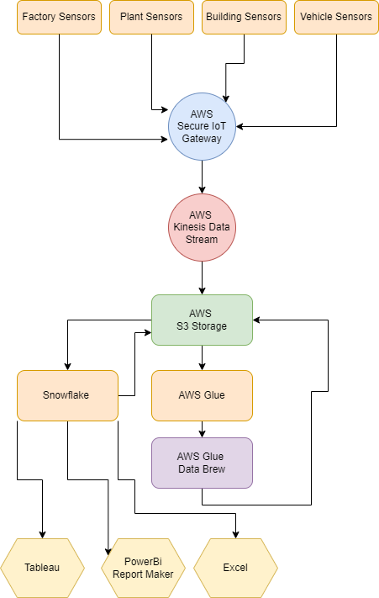
Cloud Design Chart

Slide 9
Finance Analysis
Setup Costs - $300,000 (High End)
Monthly Cost - $5,210 (High End)
Sensors Costs of $250,000 (500 * $500) - Initial Setup
AWS Connection IoT Core - Setup Cost of $50,000 - Maybe a Contract Required with AWS
AWS IoT Core - Messages Cost - $1,000 - $2,000 for 1 Million Messages
AWS Kinesis Data Stream - By Hour and Payload - $300 - $600 Per Month
AWS S3 Storage Costs - $200 - $500 Month
AWS Glue Pricing - Including Data Brew Cleaning - $200 - $400 Month
Snowflake Usage, Storage and Pricing - $500 - $2000 Month
Tableau Usage, PowerBi and Excel Costs - $70 - $210 Month

Slide 10
Call for Action
Why it’s a good idea:
Implementing a robust carbon emission monitoring system
Aligns with our commitment to sustainability and responsible business practices
Accurately tracks and manages our carbon footprint
Meets regulatory requirements
Demonstrates dedication to environmental stewardship
Investing in cutting-edge technology highlights commitment to innovation and industry leadership

Slide 11
Call for Action
Expected benefits:
Potential for significant cost savings through improved energy efficiency and reduced regulatory fines
Enhances brand reputation as sustainable and environmentally-conscious
Leads to increased customer loyalty and investor confidence
Contributes to broader climate change mitigation efforts
Ensures a more sustainable future for the organization and the communities served

Slide 12
Call for Action
Conclusion:
Investing in a carbon emission monitoring system is a strategic imperative
Demonstrates commitment to sustainability and responsible corporate citizenship
Expects tangible benefits financially and reputationally
Contributes to broader environmental goals
Requests support in funding the project
Confident in achieving shared objectives together

Slide 13
Thank You
Any Questions, Comments or Feedback?

